Slide 1
Sequence Maps

Slide 2
Learning Objectives
To introduce various types of biological data in the context of genomics patterns
To understand the biological rationale for developing and implementing motif finding algorithms

Slide 3
Sequencing as a biochemical readout
Sequence can indicate enrichment of regions
ChIP-seq
RNA-seq
Sequence can indicate the precise location of an event (there is information in the 5’ end of the read)
CAGE
DNase-seq

Slide 4
ChIP-seq
(more about this later in the course!)

Slide 5

Post-genome 2001
Variation, GWAS
Understanding
The genome
(ENCODE)

Slide 6
Human genome project
Working draft in 2001
In 2003 the NHGRI launched the ENCODE project to identify all “functional elements” in the human genome
Phase I: 1% of genome (ended 2007)
Phase II: Build-out phase (ended 2012)
Phase III: Production phase (ending 2016)
Phase IV: We have to go deeper (starting 2016-2017)

Slide 7
Reading the human genome is difficult
What are the functional, non-coding, sequence elements?
Genetic code is very powerful for 1% of the genome
No correspondingly powerful regulatory code
Conservation can identify candidate elements but not when or where they act
Regulatory regions aren’t always in the same order as gene targets
Unbiased experimental investigation

Slide 8
Non-coding DNA is important for disease and evolution
About 90% of disease associated loci lie outside of protein-coding regions
About 80% of recent adaptation signatures lie outside of protein-coding regions
Non-coding DNA variants are known to cause human diseases and alter human traits
Fragile X Syndrome
ALS (amyotorpic lateral sclerosis)
Prostate Cancer
Thyroid Cancer

Slide 9
Utility of a map: 1,500 bp of our 3.4 billion bp genome
TTTCCCGGCGTGCCCCAGGAGAGCGGCGTGGACGCGTGCGGGCCTAGAGGCCCACGTGATCCGCAGGGCGGCCGAGGCAGGAAGCTGTGAGTGCGCGGTT GCGGGGTCGCATTGTGGCTACGGCTTTGCGTCCCCGGCGGGCAGCCCCAGGCTGGTCCCCGCCTCCGCTCTCCCCACCGGCGGGGAAAGCAGCTGGTGTG GGAGGAAAGGCTCCATCCCCCGCCCCCTCTCTCCCGCTGTTGGCTGGCAGGATCTTTTGGCAGTCCTGTGGCCTCGCTCCCCGCCCGGATCCTCCTGACC CTGAGATTCGCGGGTCTCACGTCCCGTGCACGCCTTGCTTCGGCCTCAGTTAAGCCTTTGTGGGCTCCAGGTCCCTGGTGAGATTAGAAACGTTTGCAAA CATGTCCCGGATCGAAAAGATGAGCATTCTGGGCGTGCGGAGTTTTGGAATAGAGGACAAAGATAAGCAAATTATCACTTTCTTCAGCCCCCTTACAATT TTGGTTGGACCCAATGGGGCGGGAAAGACGGTAAGTCTTCAGTAGCCGCCTTCAGTTTACAGGTCGCTACATCTTTCGGAGAATAAAATGGGAAGTTGAG AACTCTCCTTAGGAGCAGAAGCGTCCCTAGGGCTCCACAGGTGTAGGCCCTTAAAGTGCCTTAGGGTGTGGCCTGCAGGCTACAGCGACCTTAGGAGTTT GCCTGAAGCAGTCTCGGAAGGATGTCCGGACCTGGCCTGGGGACAAGGTTTACTTAAGAATCCCACGATACCGGGAGCTGTCGCCGCTCACTCAGAGTTC AGTTCCCACTGGATGCCCTTTGGTCTGTATTGATGTTTTTAACGCTGTCTCCTTGCTTTCAAAGCATAGCATTCACTTCCCAGTAGTTGTCCCATACAAG AATTCCTTTAAAAGTTATAAAATGATACATACATGACTAAAGAGTTTCCAAGTATGCCAACTGTCCAGACATAATACATGGAAAATAAATAAATTCAAAA TGTAACTGATGTAGTGGGGCTTAACTTGGAAAACTTCTCTTCTTAAAACTCAGTCAAAAATTTAACGTTGGTGCACGACTGACTTTTTTTTTTTTTTAAA GCCGTGGGAATATTTATAAATTTGAATGGAAAGAATAACCAAGAGGCATTCTGGTCAGGAATAGTGGCTTAAGAAAAAGCAAGACGATGTCAGTATAGCA GGGAGAAGAGTCTAAAGGAAGGATTTGTGAAGAGTGTAGAAAGAGAGAAGGTTGAGAATTGAATGCCAAACTTGTTTACTTTTGTTTTTGTAAAAATGTT ATTTGTTGAATGCTTGTTATGTACTTAGGATTGTACTAAATACTAGCAGAAGGGAGAGTAGTACTGTATAGTGTTTATGAGGACTGGCTGCCTCAATACA GCTTTTTCGCTTCATTTATTAGTTGTCTGATTGTTTGCGAGTGACCTCACTGCTCTGTGCCTTAGTTTTCTCATTTATAAAATGGAGATTAAAAATAGTT TCTACAGCTGGGCACGGTGGCTCACGCCTGTAATCCCAGCACTTTGGGAGGCCGAGGCGGGTGGATCACCTGAGGTCAGGAGTTCGAGACCAGCCTGGCC AACGTGGCGAAACCCCATCTCTAATAAAAATACAAAAATTAGCCAGGCGTGGTGGCGCATGCCTGTAATCCTAGCTACTGGGGAGGCCGAGGCGGGAGAA TCGCTTGAACCGGGGAGGTGGAGGTTGCAGTGAGCCGAGATCACGCCATTGCACTACACCAGCCTGGGTGACAGAGGGAGACTCTCTCCCCCCACAAAAA AAAAAAAAAAAAAAAAAAAGTTTCTACAGGCTGGGCATGGTGGCTGACGACTGTAATCCGAGCCGTTTGGGAGGCTGAGGCTGGGGGATTGCTTGAGCCC AGGAGGTCGAGAGGTCGAGGCTGCAGTAAGCCATGATCATGCAGCTGCACTGCAGCCTGGGCAGCAGAATGAGACCCTGTCTCTTAAACAAAAAGTTCCT ACAGCCTGGAGTTAATGTGAGAATTAAATAAATGTATGTAAGAGTGCTTAGTACAATACAGTACTTAACTGTTAGCCATTCTTATTATTAACTTAAATTA GTTTAAAGGGTTTCAGTTGAAAATAATTATTTTTTTCCCAAGTAACAATTCTTCATATTAGGATAACTTCTTAGTTATATAGCATTTCTGTGAACTTACA GCATTAACACTTAATCATATTTTTATTACAGGTTTTATAATGTCAGATTTTATCTTTTATAGTTTCCATGATAAATAATATTTTTGTAATGAATTCATAT TTTATGGTAAACTTCTGTGGTTCTCTTATAACGAAATAATGTAATTTTCTATTTCTTTAGACCATCATTGAATGTCTAAAATATATTTGTACTGGAGATT TCCCTCCTGGAACCAAAGGAAATACATTTGTACACGATCCCAAGGTAATGGTGCTAGTACAATTTTGTATTTTTATAATTATAAAAATGATAATAGCTTA TTATAGAAAACTTGGCACTGGAAAACTATAAAGAGAAATGAAAGTCAGCCCCACACAGTTTTAGCACCCAGTAGTAACCGTTGTTGACATTTTCATGTGT TTTCCTCCTCCTTTAAATACTGTTTTATATAGCTGATGTCATACTCTTAATTTTGTATTCTGGGTTTTTTTCCCCACTTAACATTATCATGAAGTCCTAT GTCATTAAAAAACTATCATCTGGGTGTTTGGTATGTAAGTGTTTCTTTTAATCTTTATACTGCTTTGTATGTCTGAGATATTTTCTACTTAAAGTGCATG AACACTTTAGTAGTTATGTAATTTTCTTACATTAGATTGCTTTCAGTTTTTCATTAAAATGTACCATGATAAGCCAGGCTTGGGGGTGTGTGCCAATACT CCCAGATAGCTCTAGAGGCTGAGATGGGAGGATTGCTTCAGCCCAGGAGTTCAAGGCTAGCCTGGACAATATAGTGAGACCCACTGTCTAGAAAAAAAAG
ATCATGATAAAAATCTTTGTGTATGAATCATTGTTTGAATTATGGTGTT TATACTATTCGTATGTGTAAAGGACATAGAATTTGGTCTATAGGTTTGTT

Slide 10
Maps and Annotation help us to understand the sequence
TTTCCCGGCGTGCCCCAGGAGAGCGGCGTGGACGCGTGCGGGCCTAGAGGCCCACGTGATCCGCAGGGCGGCCGAGGCAGGAAGCTGTGAGTGCGCGGTT GCGGGGTCGCATTGTGGCTACGGCTTTGCGTCCCCGGCGGGCAGCCCCAGGCTGGTCCCCGCCTCCGCTCTCCCCACCGGCGGGGAAAGCAGCTGGTGTG GGAGGAAAGGCTCCATCCCCCGCCCCCTCTCTCCCGCTGTTGGCTGGCAGGATCTTTTGGCAGTCCTGTGGCCTCGCTCCCCGCCCGGATCCTCCTGACC CTGAGATTCGCGGGTCTCACGTCCCGTGCACGCCTTGCTTCGGCCTCAGTTAAGCCTTTGTGGGCTCCAGGTCCCTGGTGAGATTAGAAACGTTTGCAAA CATGTCCCGGATCGAAAAGATGAGCATTCTGGGCGTGCGGAGTTTTGGAATAGAGGACAAAGATAAGCAAATTATCACTTTCTTCAGCCCCCTTACAATT TTGGTTGGACCCAATGGGGCGGGAAAGACGGTAAGTCTTCAGTAGCCGCCTTCAGTTTACAGGTCGCTACATCTTTCGGAGAATAAAATGGGAAGTTGAG AACTCTCCTTAGGAGCAGAAGCGTCCCTAGGGCTCCACAGGTGTAGGCCCTTAAAGTGCCTTAGGGTGTGGCCTGCAGGCTACAGCGACCTTAGGAGTTT GCCTGAAGCAGTCTCGGAAGGATGTCCGGACCTGGCCTGGGGACAAGGTTTACTTAAGAATCCCACGATACCGGGAGCTGTCGCCGCTCACTCAGAGTTC AGTTCCCACTGGATGCCCTTTGGTCTGTATTGATGTTTTTAACGCTGTCTCCTTGCTTTCAAAGCATAGCATTCACTTCCCAGTAGTTGTCCCATACAAG AATTCCTTTAAAAGTTATAAAATGATACATACATGACTAAAGAGTTTCCAAGTATGCCAACTGTCCAGACATAATACATGGAAAATAAATAAATTCAAAA TGTAACTGATGTAGTGGGGCTTAACTTGGAAAACTTCTCTTCTTAAAACTCAGTCAAAAATTTAACGTTGGTGCACGACTGACTTTTTTTTTTTTTTAAA GCCGTGGGAATATTTATAAATTTGAATGGAAAGAATAACCAAGAGGCATTCTGGTCAGGAATAGTGGCTTAAGAAAAAGCAAGACGATGTCAGTATAGCA GGGAGAAGAGTCTAAAGGAAGGATTTGTGAAGAGTGTAGAAAGAGAGAAGGTTGAGAATTGAATGCCAAACTTGTTTACTTTTGTTTTTGTAAAAATGTT ATTTGTTGAATGCTTGTTATGTACTTAGGATTGTACTAAATACTAGCAGAAGGGAGAGTAGTACTGTATAGTGTTTATGAGGACTGGCTGCCTCAATACA GCTTTTTCGCTTCATTTATTAGTTGTCTGATTGTTTGCGAGTGACCTCACTGCTCTGTGCCTTAGTTTTCTCATTTATAAAATGGAGATTAAAAATAGTT TCTACAGCTGGGCACGGTGGCTCACGCCTGTAATCCCAGCACTTTGGGAGGCCGAGGCGGGTGGATCACCTGAGGTCAGGAGTTCGAGACCAGCCTGGCC AACGTGGCGAAACCCCATCTCTAATAAAAATACAAAAATTAGCCAGGCGTGGTGGCGCATGCCTGTAATCCTAGCTACTGGGGAGGCCGAGGCGGGAGAA TCGCTTGAACCGGGGAGGTGGAGGTTGCAGTGAGCCGAGATCACGCCATTGCACTACACCAGCCTGGGTGACAGAGGGAGACTCTCTCCCCCCACAAAAA AAAAAAAAAAAAAAAAAAAGTTTCTACAGGCTGGGCATGGTGGCTGACGACTGTAATCCGAGCCGTTTGGGAGGCTGAGGCTGGGGGATTGCTTGAGCCC AGGAGGTCGAGAGGTCGAGGCTGCAGTAAGCCATGATCATGCAGCTGCACTGCAGCCTGGGCAGCAGAATGAGACCCTGTCTCTTAAACAAAAAGTTCCT ACAGCCTGGAGTTAATGTGAGAATTAAATAAATGTATGTAAGAGTGCTTAGTACAATACAGTACTTAACTGTTAGCCATTCTTATTATTAACTTAAATTA GTTTAAAGGGTTTCAGTTGAAAATAATTATTTTTTTCCCAAGTAACAATTCTTCATATTAGGATAACTTCTTAGTTATATAGCATTTCTGTGAACTTACA GCATTAACACTTAATCATATTTTTATTACAGGTTTTATAATGTCAGATTTTATCTTTTATAGTTTCCATGATAAATAATATTTTTGTAATGAATTCATAT TTTATGGTAAACTTCTGTGGTTCTCTTATAACGAAATAATGTAATTTTCTATTTCTTTAGACCATCATTGAATGTCTAAAATATATTTGTACTGGAGATT TCCCTCCTGGAACCAAAGGAAATACATTTGTACACGATCCCAAGGTAATGGTGCTAGTACAATTTTGTATTTTTATAATTATAAAAATGATAATAGCTTA TTATAGAAAACTTGGCACTGGAAAACTATAAAGAGAAATGAAAGTCAGCCCCACACAGTTTTAGCACCCAGTAGTAACCGTTGTTGACATTTTCATGTGT TTTCCTCCTCCTTTAAATACTGTTTTATATAGCTGATGTCATACTCTTAATTTTGTATTCTGGGTTTTTTTCCCCACTTAACATTATCATGAAGTCCTAT GTCATTAAAAAACTATCATCTGGGTGTTTGGTATGTAAGTGTTTCTTTTAATCTTTATACTGCTTTGTATGTCTGAGATATTTTCTACTTAAAGTGCATG AACACTTTAGTAGTTATGTAATTTTCTTACATTAGATTGCTTTCAGTTTTTCATTAAAATGTACCATGATAAGCCAGGCTTGGGGGTGTGTGCCAATACT CCCAGATAGCTCTAGAGGCTGAGATGGGAGGATTGCTTCAGCCCAGGAGTTCAAGGCTAGCCTGGACAATATAGTGAGACCCACTGTCTAGAAAAAAAAG
TATCATGATAAAAATCTTTGTGTATGAATCATTGTTTGAATTATGGTGTT TATACTATTCGTATGTGTAAAGGACATAGAATTTGGTCTATAGGTTTGTT
Notes:
Alergy and asthma
Falls in an intron of this DNA repair gene

Slide 11
Richer maps provide more information

Slide 12
Richer maps provide more information

Slide 13
Richer maps provide more information
Notes:
Regulatory region

Slide 14
Richer maps provide more information
Notes:
While it lies in this DNA repair gene, you can predict that it actually regulates the neighboring cytokine genes known to be important in allergy and asthma

Slide 15
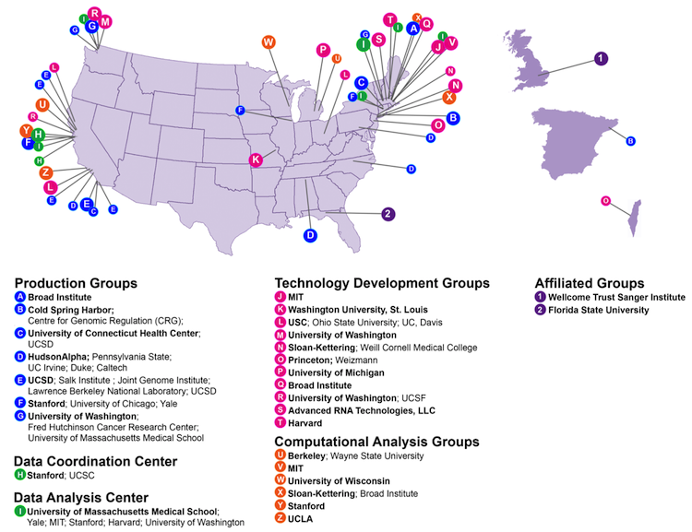
ENCODE Consortium

Slide 16
Goals of ENCODE
Catalog all functional elements in the genome
Freely share resource for community
Study human as well as other species
Project components:
Data generation
Data analysis
Data repository

Slide 17
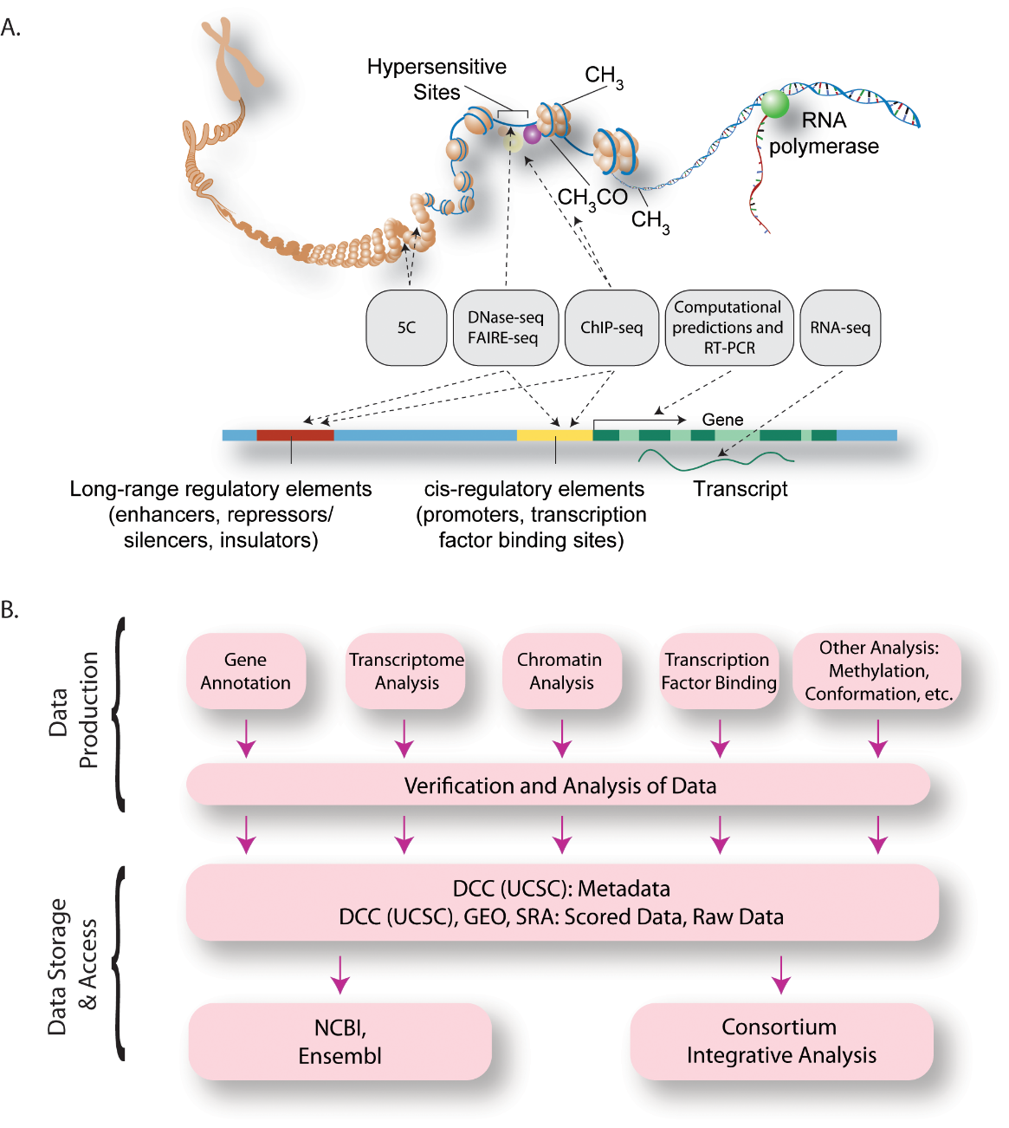
Original ENCODE Project Data Production and Access Scheme

Slide 18
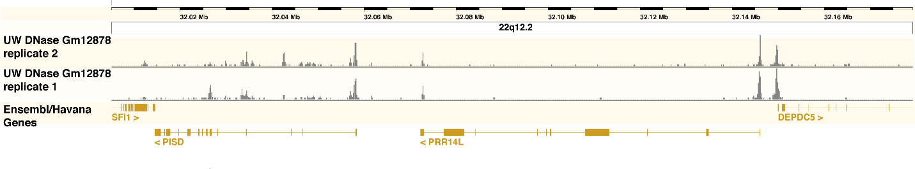
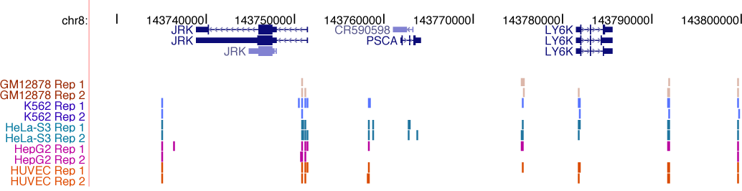
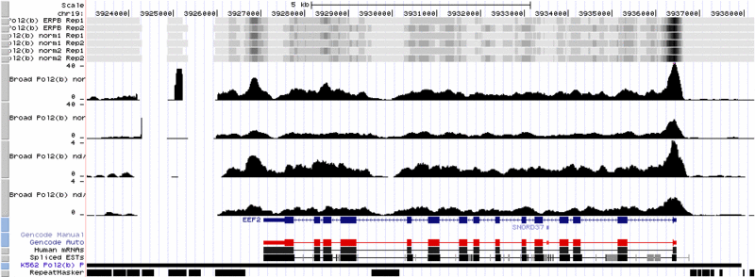
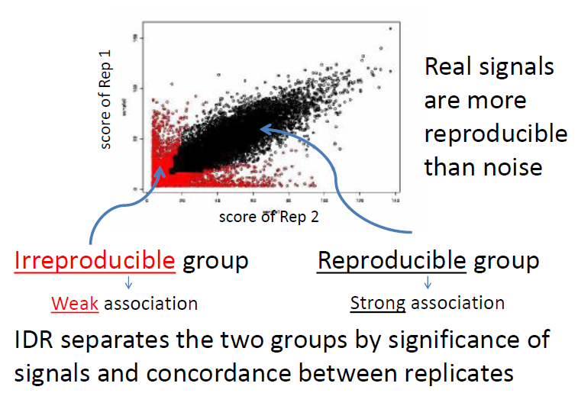
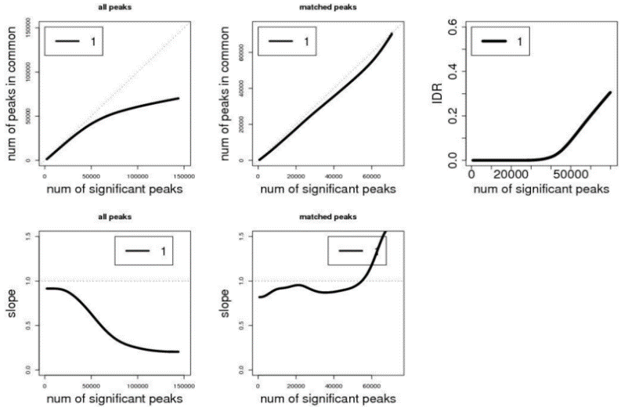
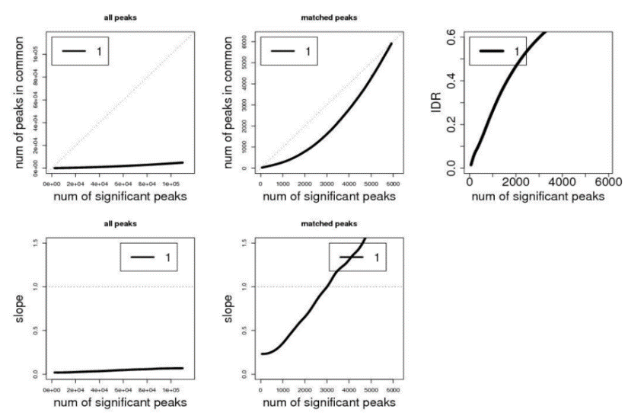
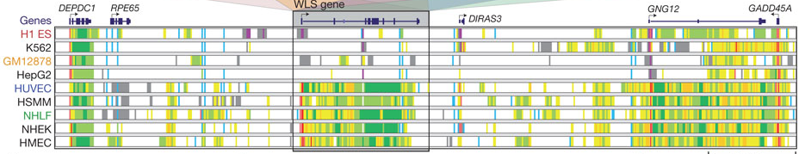
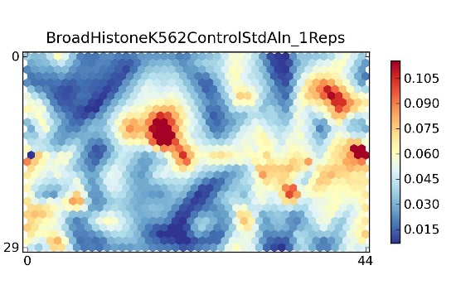
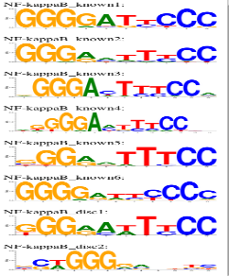
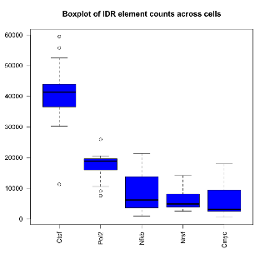
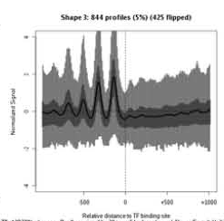
ENCODE Uniform Analysis Pipeline
Mapped reads from production (Bam)
Uniform Peak Calling Pipeline (SPP, PeakSeq)
Signal Generation
(read extension and mappability correction)
Good reproducibility
Poor reproducibility
Segmentation
Rep2
Rep1
IDR Processing, QC and Blacklist Filtering
ChromHMM/Segway
Motif Discovery
Stats, GSC enrichments, etc.
Signal Aggregation
over peaks
Self Organising Maps

Slide 19
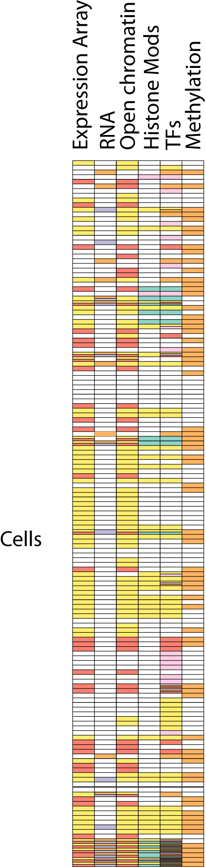
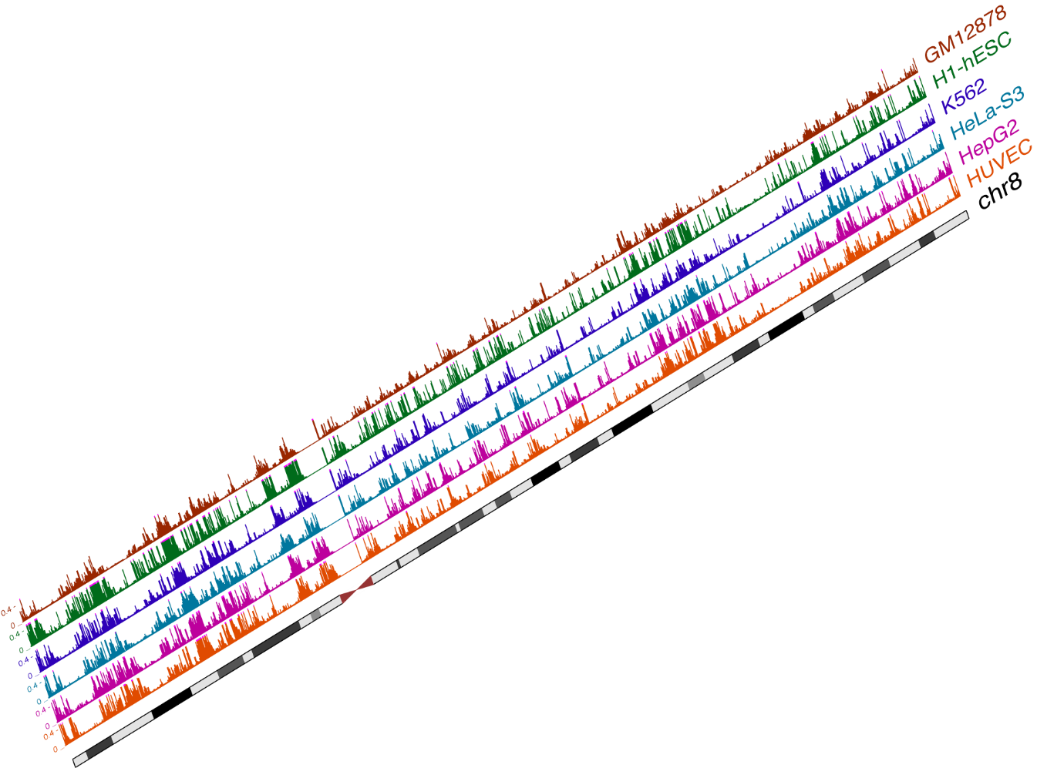
ENCODE (ENCyclopedia Of DNA Elements)
3,010 Experiments
5 TeraBases
1716x of the Human Genome
Cells
182 Cell Lines/ Tissues
Genome
The ENCODE Project Consortium. Nature 2012
164 Assays (114 different Chip)
Methods/Factors
Notes:
Broad and deep

